Slide 1
USA Used vehicle Market analysis
Presenters: Project Team 7
Anjana Sanjeev
Yuoro Ghun
Dhiraji Kappor
Deon Joshua
Ina Luo

Slide 2

Project Scenario
Our corporate client Used-Car Online Pty Ltd (UCO) is asking us to provide a comprehensive data analysis of the used car online market in the USA, according to the dataset file named ‘Vehicles.csv’. UCO requires us the following:
Demonstrate a clear data frame to list ['id', 'region', 'price', 'year', 'manufacturer', 'model', 'condition', 'cylinders', 'fuel', 'odometer', 'title_status', 'transmission', 'drive', 'size', 'type', 'paint_color', 'description', 'county', 'state', 'lat', 'long', 'posting_date’]
Summarize key information:
Which type of cars were mostly listed – Anjana
What is the most popular color listed – Deon
Correlation between odometer (kms run) and price of the car. – Dhiraj
The top 10 state ranking by the most cars listed – Ina
Based on the listed key information, UCO requests us to find out: What is the most profitable way to sell cars online in USA market? This may include:
Saturation in the market
What types of colors are popular
Which type of cars are most listed
Which state is the most potential market

Slide 3
Dataset clean
Dataset Source from: https://www.kaggle.com/datasets/austinreese/craigslist-carstrucks-data?resource=download

Slide 4
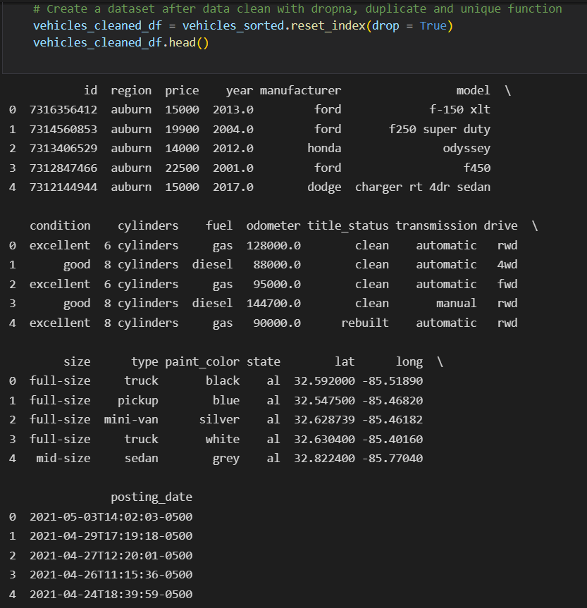
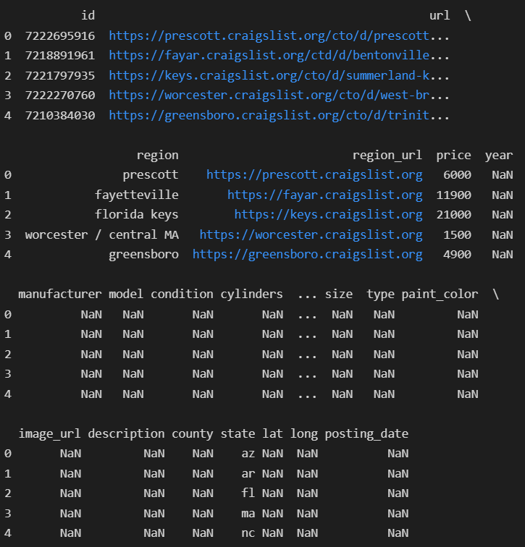
Clean raw dataset by drop(),drupna(), duplicate(), unique(), find inform from 2000, reset index, then save into output_data folder

Slide 5
EDA – USA USED VEHICLE MARKET ANALYSIS The top 10 state ranking by number of vehicle listed and their correlation with the population of each state
EDA Methodology:
upper(): to capitalize the state abbreviation in the column of ‘state’
groupby(): to create a new data frame ‘geo_df’ with ‘state’ as an index and 3 columns ‘lat’, ‘long’ and ‘Total_Listed’
sort_values(by=‘Total_Listed’) and head(10): to find the top 10 states ranking by the number of vehicles listed
merge(), loc() & for loop: to merge cleaned vehicle data with USA population & state abbreviation datasets
stats.pearsonr(),stats.linregress(): to calculate correlation coefficient and linear regression

Slide 6
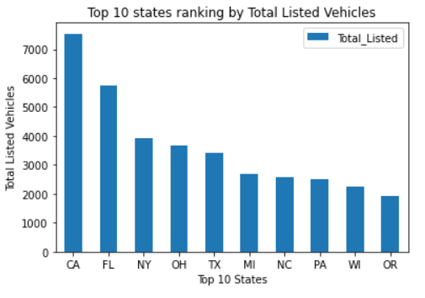
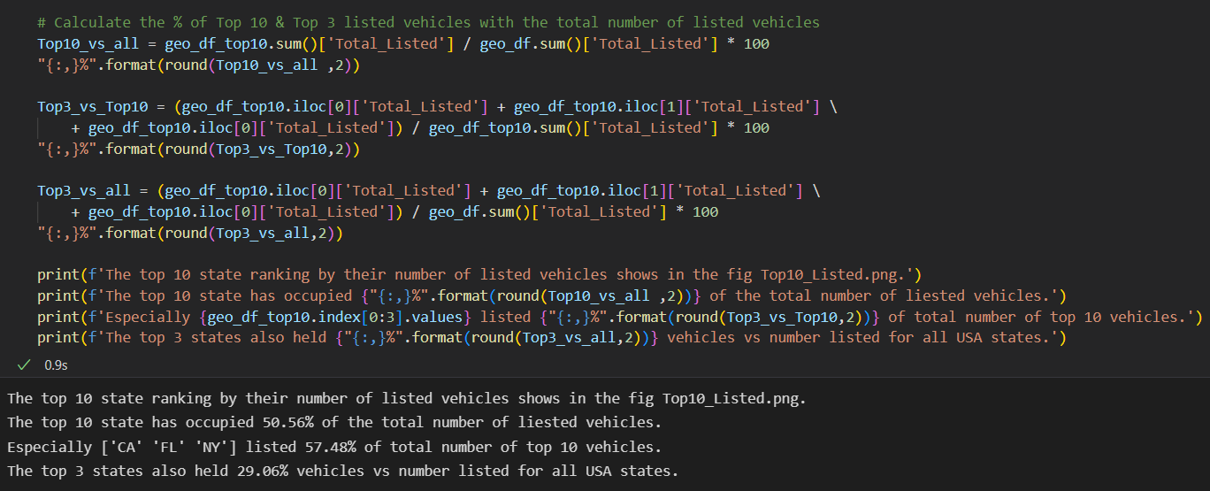
USA USED VEHICLE MARKET ANALYSIS The top 10 state ranking by the number of vehicles listed and their correlation with the population of each state
EDA & Visualization:
Summary: The top 10 states have occupied more than half of the total number of listed vehicles. Especially the top 3 states California, Florida & New York State. The top 3 states share nearly one-third of listed vehicle numbers and generally consider California will be the biggest potential market followed by Floria & New York States. And the other states in the top 10 could be covered in the 2nd stage of marketing strategical development.

Slide 7
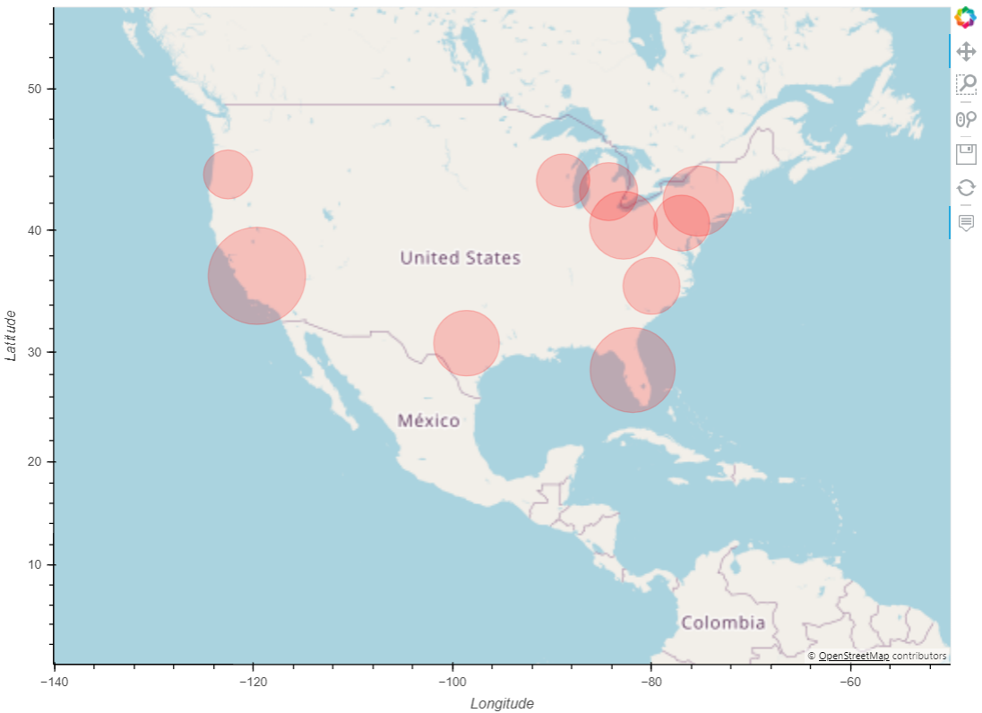
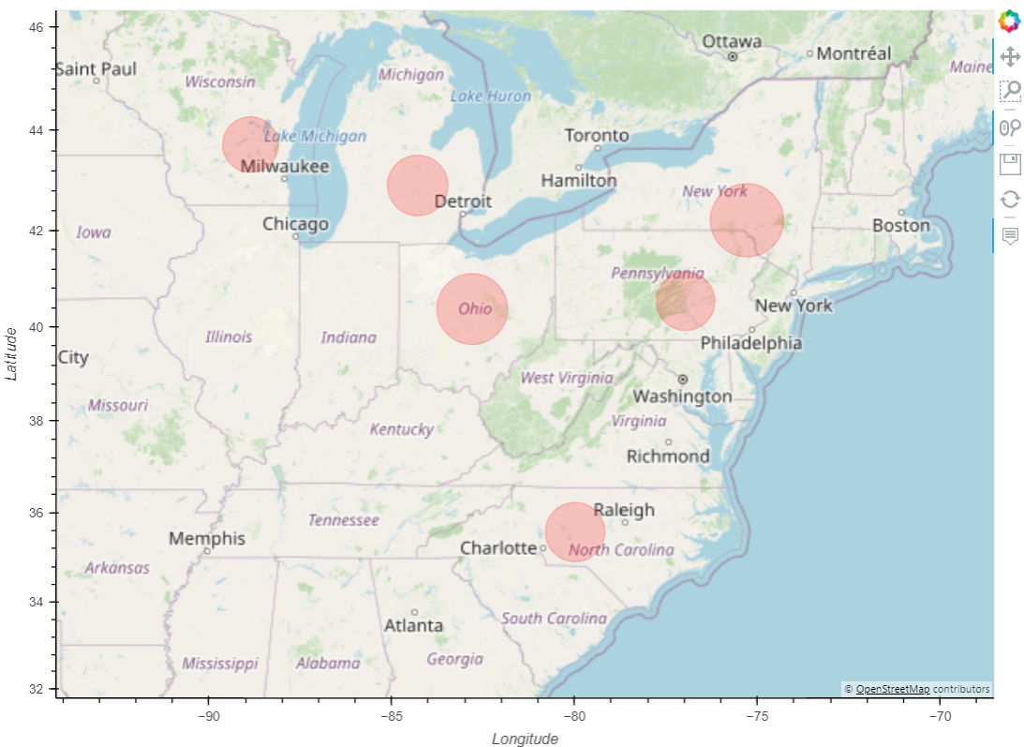
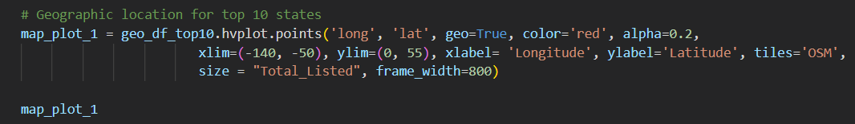
USA USED VEHICLE MARKET ANALYSIS The top 10 state ranking by the number of vehicles listed and their correlation with the population of each state
Summary: The hvplot with the open map shows the geographical location of the top 10 states by their longitude and latitude. It is obvious to find out the top 10 states mainly located on the eastern or western coasts of USA. The size of the bubble reflects the total number of listed vehicles. This will be clearly identified that Califonia held the largest number of listed vehicles followed by Florida and New York State.

Slide 8
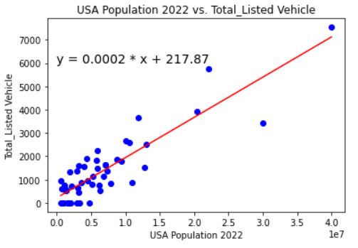
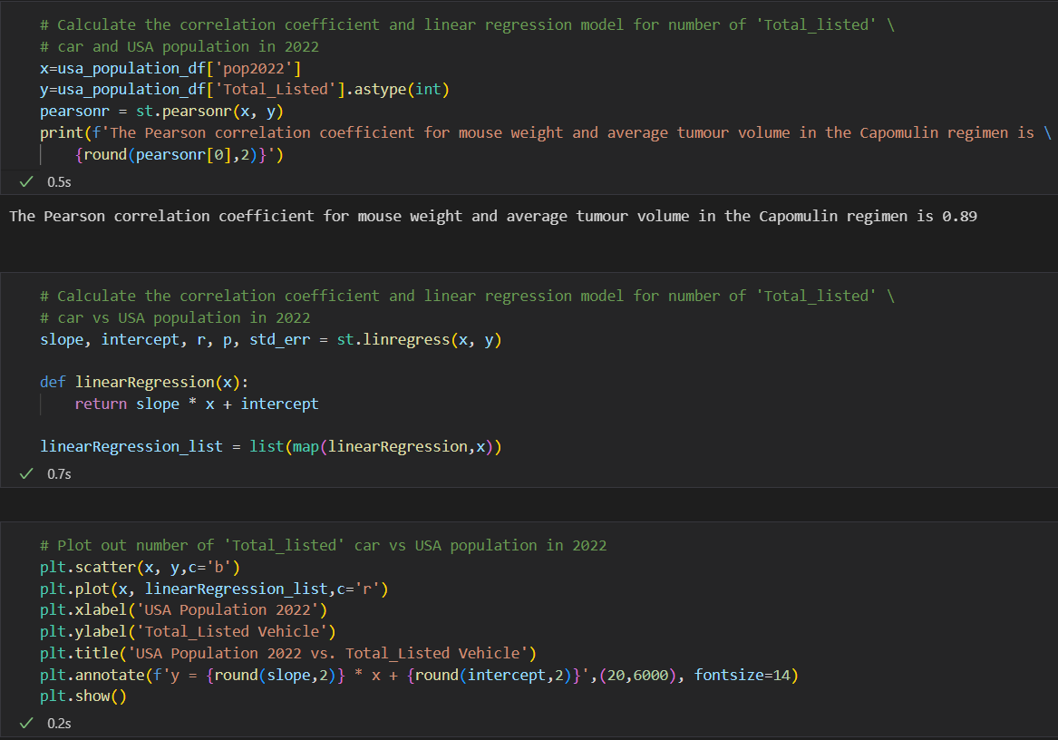
USA USED VEHICLE MARKET ANALYSIS The top 10 state ranking by the number of vehicles listed and their correlation with the population of each state
Import a dataset regarding USA population names 'data.csv' for merging with 'Total_listed' data and complete correlation analysis Dataset Source from: https://worldpopulationreview.com/states/state-abbreviations & https://worldpopulationreview.com/states
Summary: The Pearson’s r is 0.89 and means a fairly strong positive relationship between the population and the number of listed vehicles. This reminds us to focus on developing online sales markets in the states with a larger population.

Slide 9
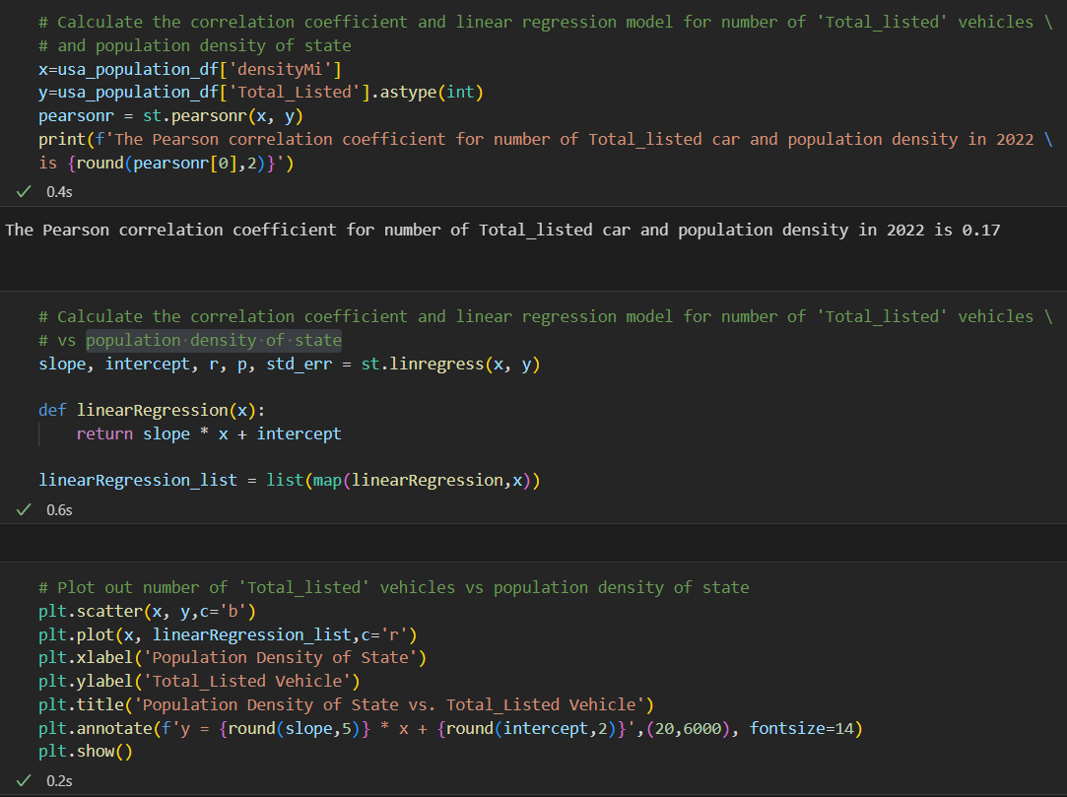
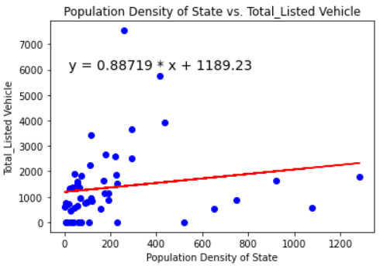
USA USED VEHICLE MARKET ANALYSIS The top 10 state ranking by the number of vehicles listed and their correlation with the population of each state
Summary: The Pearson’s r is 0.17 only. The value is considered to be a weak correlation between the population density of the state and the total listed vehicles. The population density will not the factor to affect the used vehicle market in USA

Slide 10
Summary
Based on the listed key information, UCO requests us to find out:
What is the most profitable way to sell cars online in USA market? This may include:
Saturation in the market
What types of colors are popular
Which type of cars are most listed
Which state is the most potential market?
The top 3 potential market is California, Florida, and New York State. These top 3 states are occupied one-third of the total listed vehicles. Geographically, the states located on the western and eastern coasts will be considered the better potential markets than inland areas. The Pearson correlation coefficient of 0.89 between the population in 2022 and the total listed vehicles tell us the strong relationship and the states with larger population may be better potential markets but it will not be necessary to consider the population density of states.

Slide 11




Thank you
Presenters: Project Team 7
Anjana Sanjeev
Yuoro Ghun
Dhiraji Kappor
Deon Joshua
Ina Luo

